Slide 1
Speed-Interactive Pedaling Training Using Smartphone Virtual Reality Application for Stroke Patients: Single-Blinded, Randomized Clinical Trial
Brain Sciences
Impact Factor: 3.332

Slide 2
Introduction
1. The main goal of rehabilitation in stroke patients is to improve the gait ability to be able to recover and move to the desired location.
2. When pedaling, the lower limb muscles are very similar to walking, which helps strengthen these muscles and is effective in training the reciprocal patterns of movement.
3. In the previous study, biofeedback training, electromyogram feedback training, and virtual reality training were combined to improve the effects of bicycle exercise in stroke patients.
4. This study aimed to investigate the effects of speed-interactive pedaling training (SIPT) using smartphone-based motion-tracking technology.

Slide 3
Materials and Methods
1. SIPT and Pedaling Training with a Stationary Bike
(1) iPhone 8
(2) Apple TV
(3) A stationary bike
(4) A smartphone application Virtual Active: This application provides shooting videos of mountains, valleys, and cities that are famous tourist destinations worldwide. It consists of threemodes, including walking, biking, and arm ergometer.

Slide 4
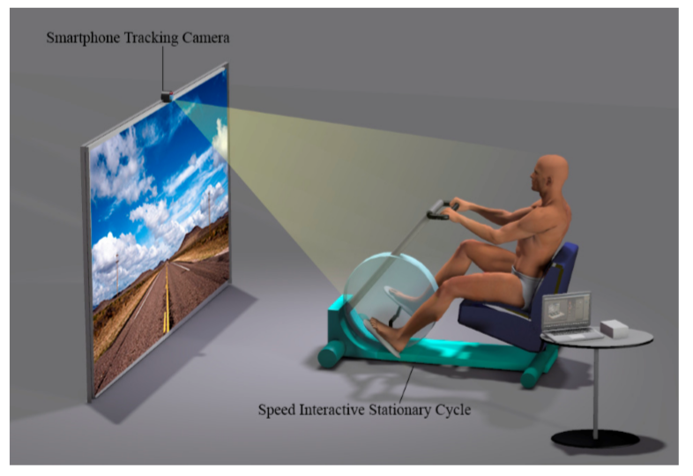

Slide 5
Materials and Methods
2. Participants
(1) Inclusion criteria
(a) Had chronic hemiplegia for six months or more due to stroke
(b) Able to sit for 30 min or more independently
(c) Able to walk more than 10 m using the assistive device (Brunnstrom motion recovery stage of 4 or greater)
(d) Had the cognitive ability to participate in the study (Mini-Mental State Examination Score > 24)
(2) Exclusion criteria
(a) Brain injury except for stroke
(b) Orthopedic (外科) problems of the legs
(c) Cardiovascular (心血管) disease
(d) Vision defects
(e) Deafness

Slide 6
Materials and Methods
2. Participants
(3) A total of 42
(a) SIPT group (n = 21)
(b) Control group (n = 21)
3. Procedure
(1) All subjects in both groups received a 60-min conventional rehabilitation program for five days per week, for six weeks.
(2) Subjects in the SIPT group performed smartphonebased pedaling training for 40 min a day.
(3) The control group performed pedaling training without SIPT for 40 min a day.

Slide 7
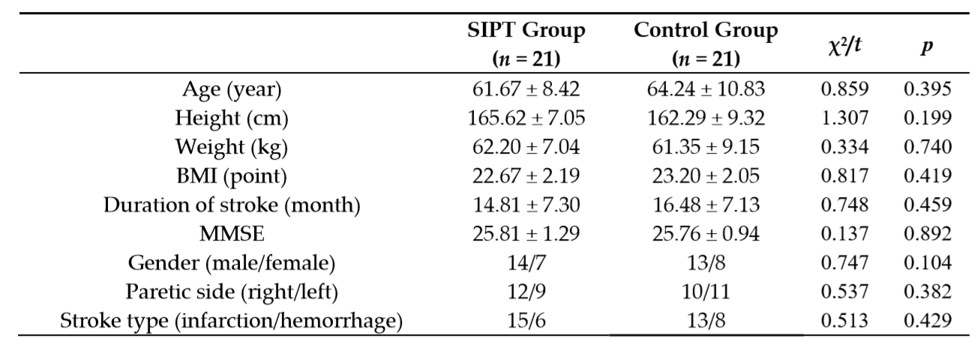

Slide 8
Materials and Methods
4. Conventional rehabilitation
(1) Therapeutic exercise: Neurodevelopmental (神经发育) therapy and upper extremity exercise.
(2) Occupational therapy: Upper extremity functional exercises to improve the activities of everyday life.
(3) Functional electrical stimulation therapy: Application to the wrist extensor.
5. Outcome Measurements
(1) The lower-extremity motor subscale of Fugl–Meyer Assessment (FMA-LE).
(2) A posturography system (GB300; Metitur Ltd., Jyvaskyla, Finland) was used to evaluate the static sitting balance.
(a) To measure the static balance, the patient sat in a chair on the force platform. Patients were asked to watch a black circle at a point of 1.5 m (5 cm in diameter) for 30 s.

Slide 9
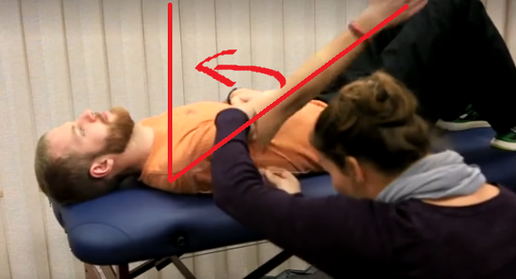
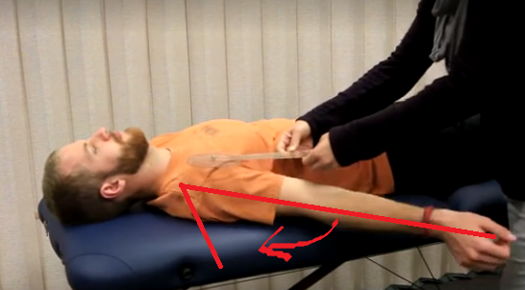
Materials and Methods
5. Outcome Measurements
(3) The dynamic sitting balance was measured using a modified functional reach test (mFRT).
(a) The subject’s hip and knee joints were bent at 90°, the chair and the popliteal area were 5 cm apart, and the feet were placed in the footrest of the chair
(b) For the forward reach test, the shoulders were flexed as far as 90°.
(c) For the lateral reach test, the shoulders were stretched laterally as far as 90° abduction.
Shoulder Flexion
Shoulder Abduction

Slide 10
Materials and Methods
5. Outcome Measurements
(4) Trunk Impairment Scale (TIS) was used to evaluate trunk function.
(5) Gait ability was evaluated with the gait analysis system (Optogait, Microgate, Bozen, Italy).
(a) Velocity
(b) Cadence (步频，正常人约为95~125 step/min)
(c) Stride time (行进中，同一脚前后两次着地的时间间隔，正常人满足 Stride time = 2*Step time)
(d) Step time (行进中，先后两步之间的时间间隔)
(e) Stride length (跨步长，指同一脚前后两次着地点的间距，正常人满足 Stride length = 2*Step length)
(f) Step length (步长，指左右脚跟的间距)

Slide 11
Results
1. At baseline, FMA, sitting balance, mFRT, TIS, and all gait variables results did not differ significantly between the intervention groups.
2. The SIPT group showed a more significant improvement compared to the control group of the FMA and TIS.
3. The changes in the static sitting balance ability showed significant improvement after intervention in both groups. The SIPT group showed a more significant improvement compared to the control group.
4. The temporal gait parameters, were a significant improvement after intervention in the SIPT group (p < 0.05), but nothing significant in the control group.

Slide 12
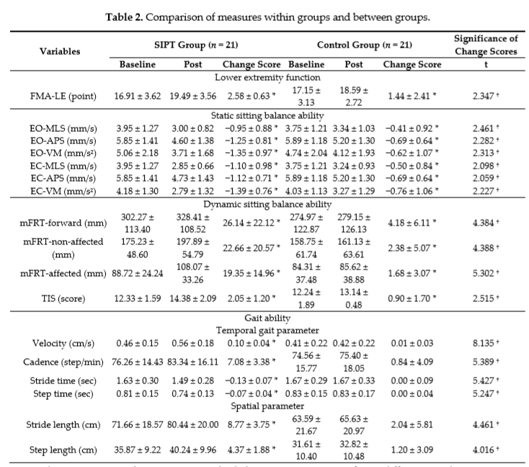

Slide 13
Discussion
1. Pedaling is possible through the movement of both legs, but there is a limitation that only the movement of the unaffected side is possible.
2. The improved results of the SIPT group using VR means that the affected side was more actively used.
3. However, it is difficult to explain the direct mechanisms of SIPT on the function of the lower extremities, body balance, and gait.
4. Studies that have applied optic flow to stroke patients have reported improvements in gait by synchronizing with the treadmill speed, and no researches have been associated with stationary bicycles.

Slide 14
Conclusion
1. The results of this study showed that SIPT is a useful rehabilitation program for the functional recovery of the lower extremities of stroke patients, improving sitting balance, trunk control, and gait.
2. The application of advanced technologies at low cost because applications used are through smartphones on existing stationary bicycles.

